Slide 1
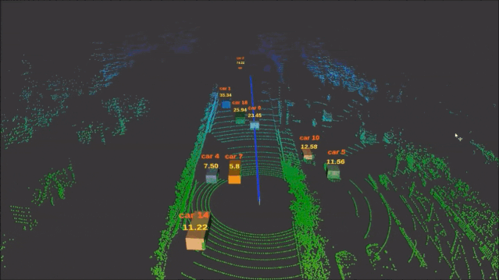


DOA Estimation
Background，Algorithms，Calculation，Detail，Conclusion
Wei Xinyuan，Zhang Yiyang
Notes:
大家好，我们本次报告的主体是软体机器人

Slide 2
Contents
01
DOA Tech Background
02
DOA Algorithms
Range-Doppler Calculation
03
04
Experience Detail
05
Conclusion
Notes:
四个部分

Slide 3
First
DOA Tech Background

Slide 4

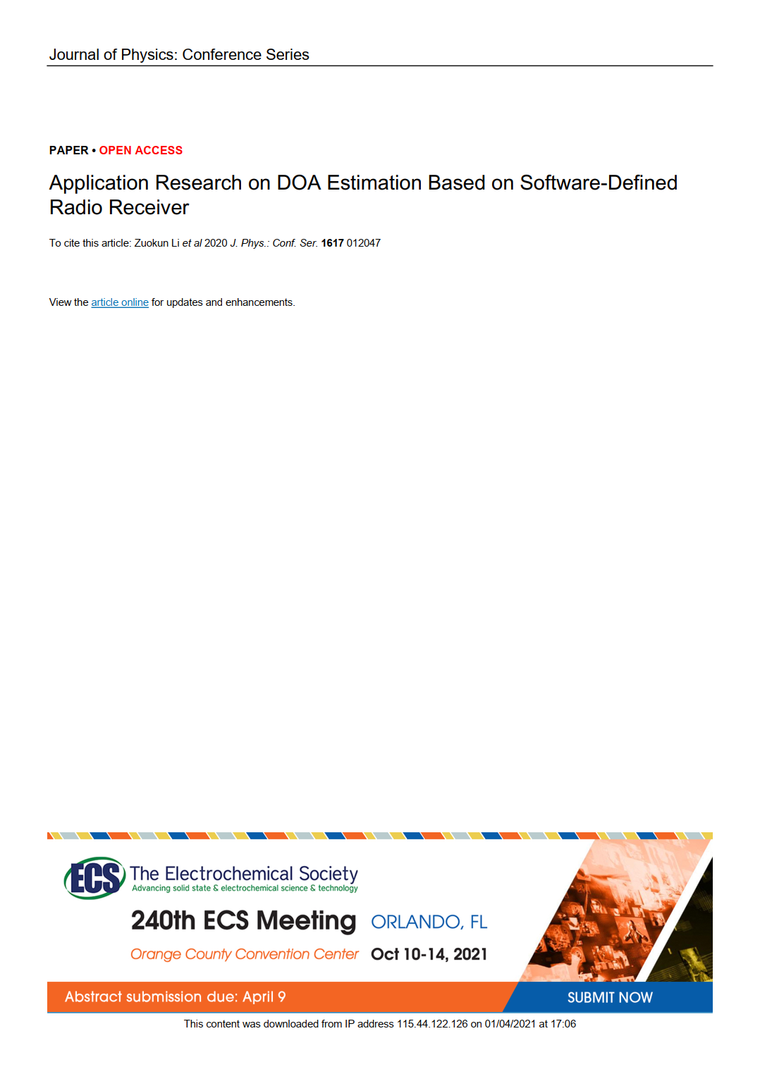

DOA Tech Background
Direction of arrival estimation is an active field in array signal processing.
It has broad application value in the fields of communication, radar , exploration and navigation.
This article focuses on the engineering application of DOA estimation

Slide 5
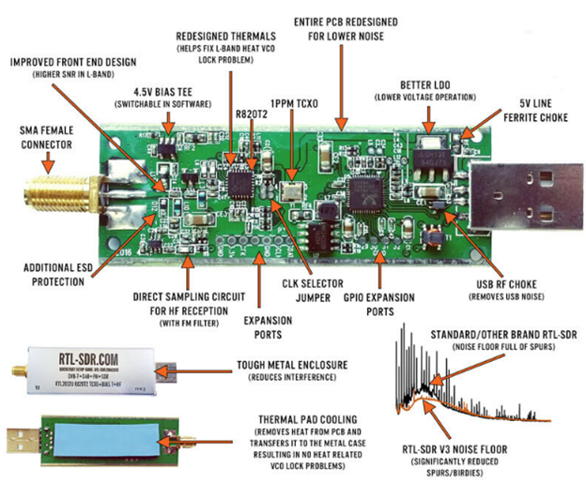
DOA Tech Background
KerberosSDR is a new 4-input Coherent RTL-SDR.
It can receive radio frequency signals from 25MHz to 1.75GHz in space and convert it to baseband.

Slide 6

DOA Tech Background
The four signal receiving channels share a clock source, and the four digital signals communicate with the Raspberry Pi through a USB HUB.
Run the signal processing algorithm on the Raspberry Pi and display the DOA estimation result and signal strength in real time through the web page.

Slide 7
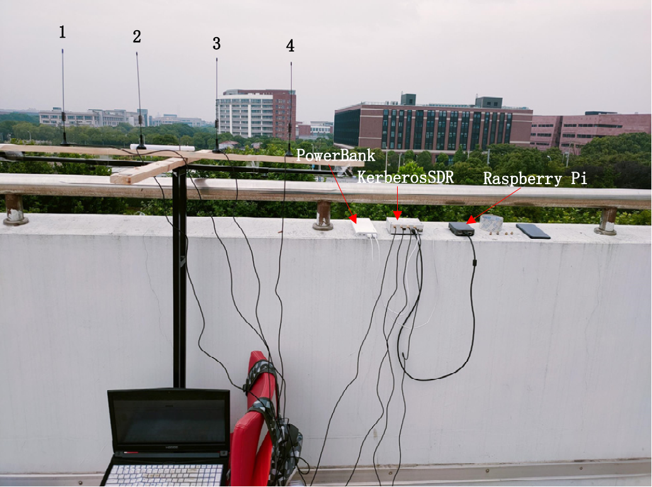
DOA Tech Background
The communication frequency between the UAV and the remote control in this experiment is 2.400- 2.4835 GHz
The UAV equipped with a FM transceiver hovers in the air, so as to ensure that the signal sent by the FM transceiver is not blocked by obstacles

Slide 8
Second
DOA Algorithms

Slide 9
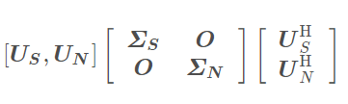
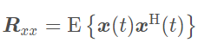
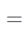
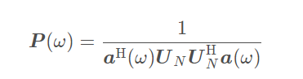
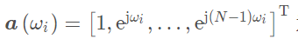
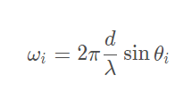
DOA Algorithms
MUSIC
利用了信号子空间和噪音子空间相互正交的性质
Multiple Signal Classification
多信号分类算法
https://blog.csdn.net/qq_36583373/article/details/109333087

Slide 10
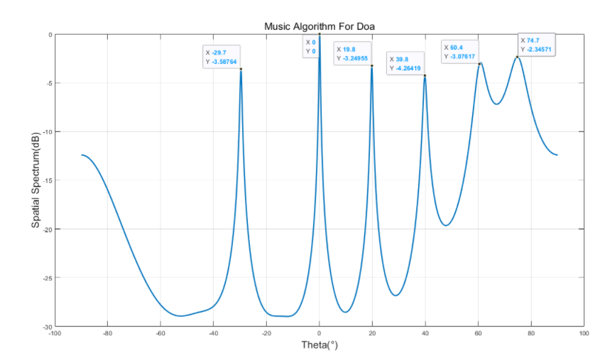
DOA Algorithms
通过改变空间参数也就是theta，进行谱峰搜索，确定信号方向
https://blog.csdn.net/qq_36583373/article/details/109333087

Slide 11
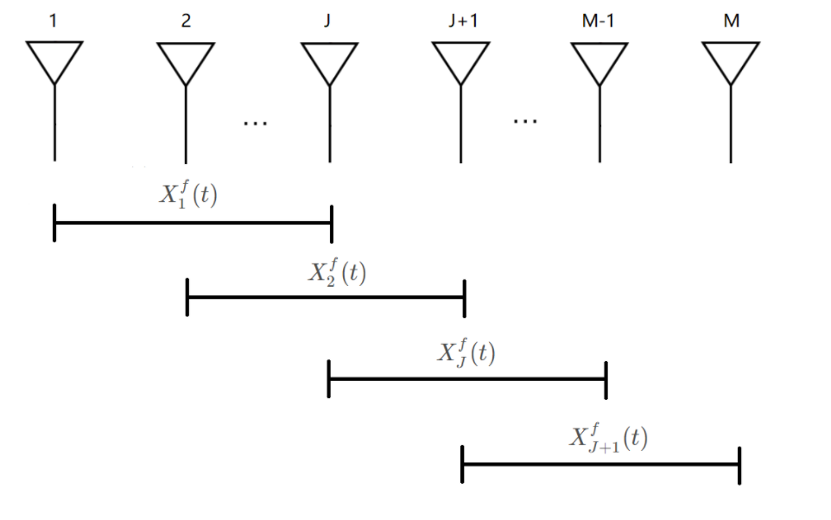
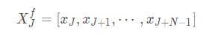
DOA Algorithms
前后向空间平滑算法
We focus on the MUSIC algorithms
Decoherence MUSIC
解相干的MUSIC算法
传统算法在处理相干信号的时候DOA结果并不理想
https://blog.csdn.net/qq_36583373/article/details/109364878

Slide 12
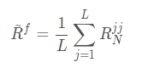
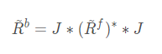
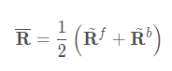
DOA Algorithms
前后向空间平滑算法
We focus on the MUSIC algorithms
Decoherence MUSIC
解相干的MUSIC算法
传统算法在处理相干信号的时候DOA结果并不理想
https://blog.csdn.net/qq_36583373/article/details/109364878

Slide 13
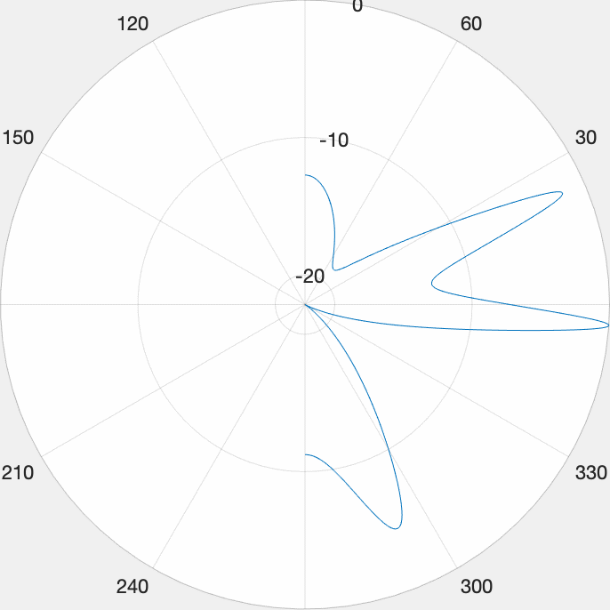
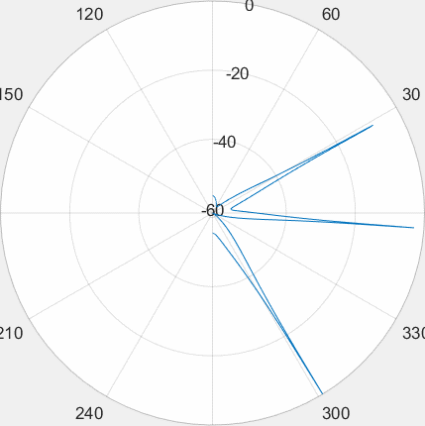
DOA Algorithms
MUSIC
Decoherence MUSIC
空间谱搜索
前后向空间平滑算法

Slide 14
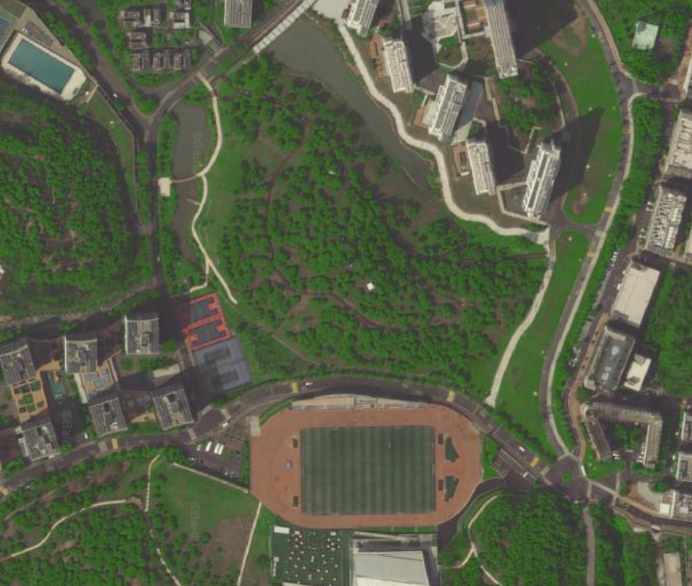
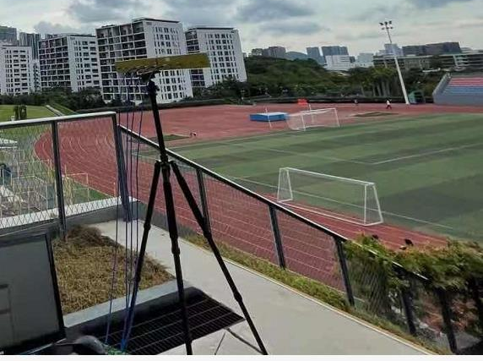
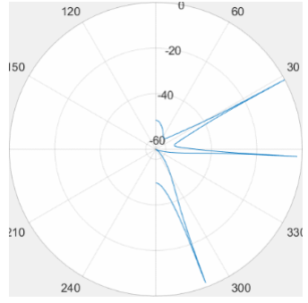
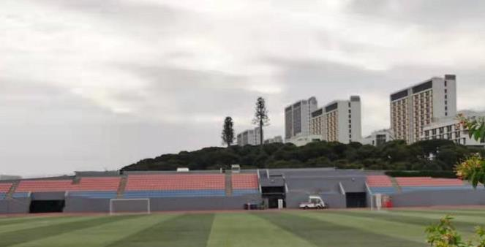
DOA Algorithms
新生宿舍
基站大概位置
专家公寓
慧园
接收机位置

Slide 15
Third
Range-Doppler Calculation

Slide 16
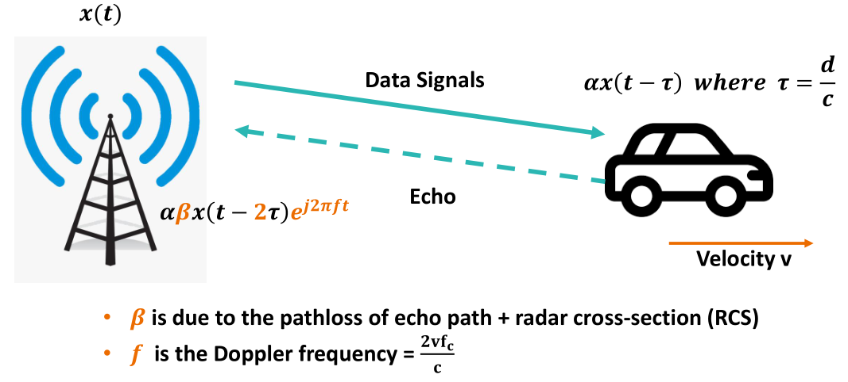
Range-Doppler Calculation
From Rui Wang’s Lecture

Slide 17
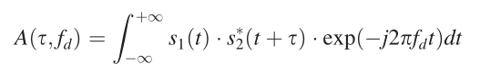
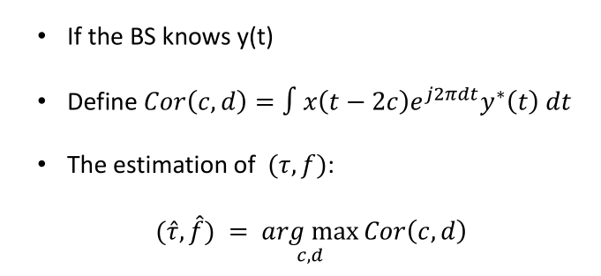
Range-Doppler Calculation
Ambiguity Function

Slide 18
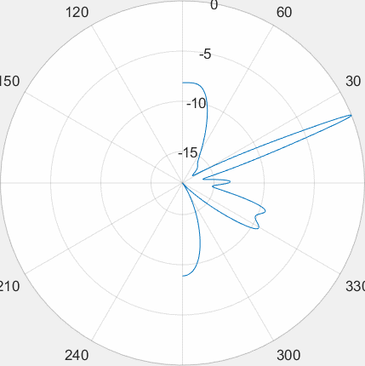
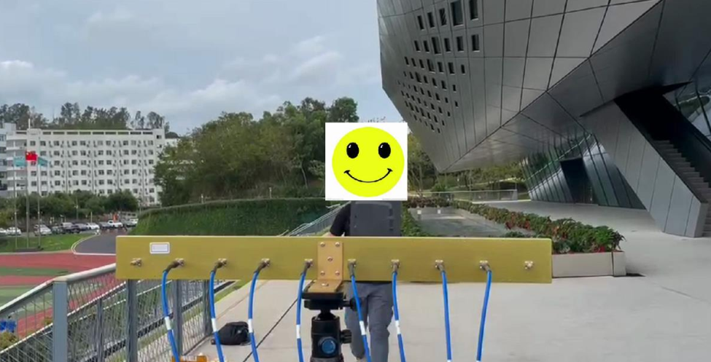
Range-Doppler Calculation

Slide 19
Range-Doppler Calculation
Deg = -20
Deg = 30

Slide 20
Range-Doppler Calculation
Deg = 29
Deg = 30
Deg = 31

Slide 21
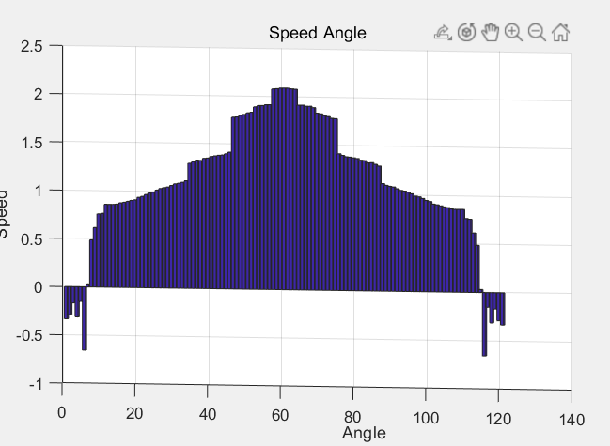
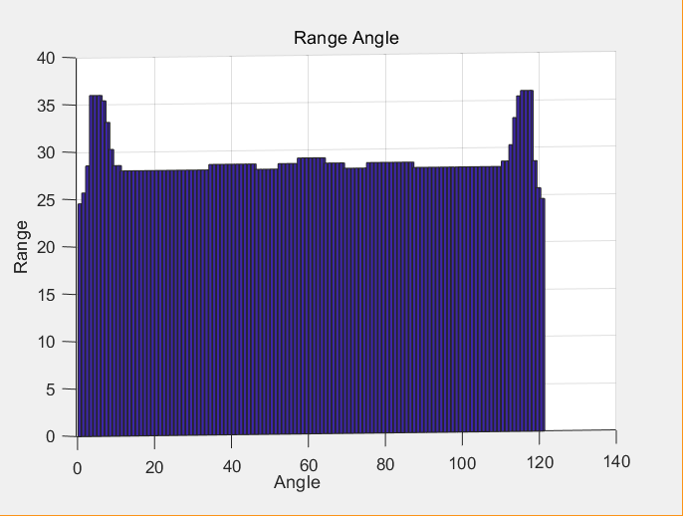
Range-Doppler Calculation
Ambiguity Function

Slide 22
Fourth
Experience Detail

